Slide 1
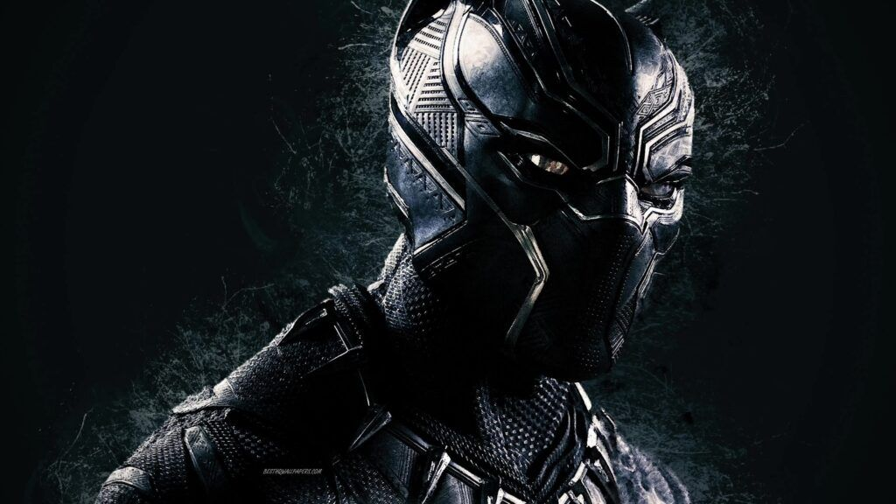
What is my name?
A.akash
B.subha
C.rock
D.jack

